Slide 1
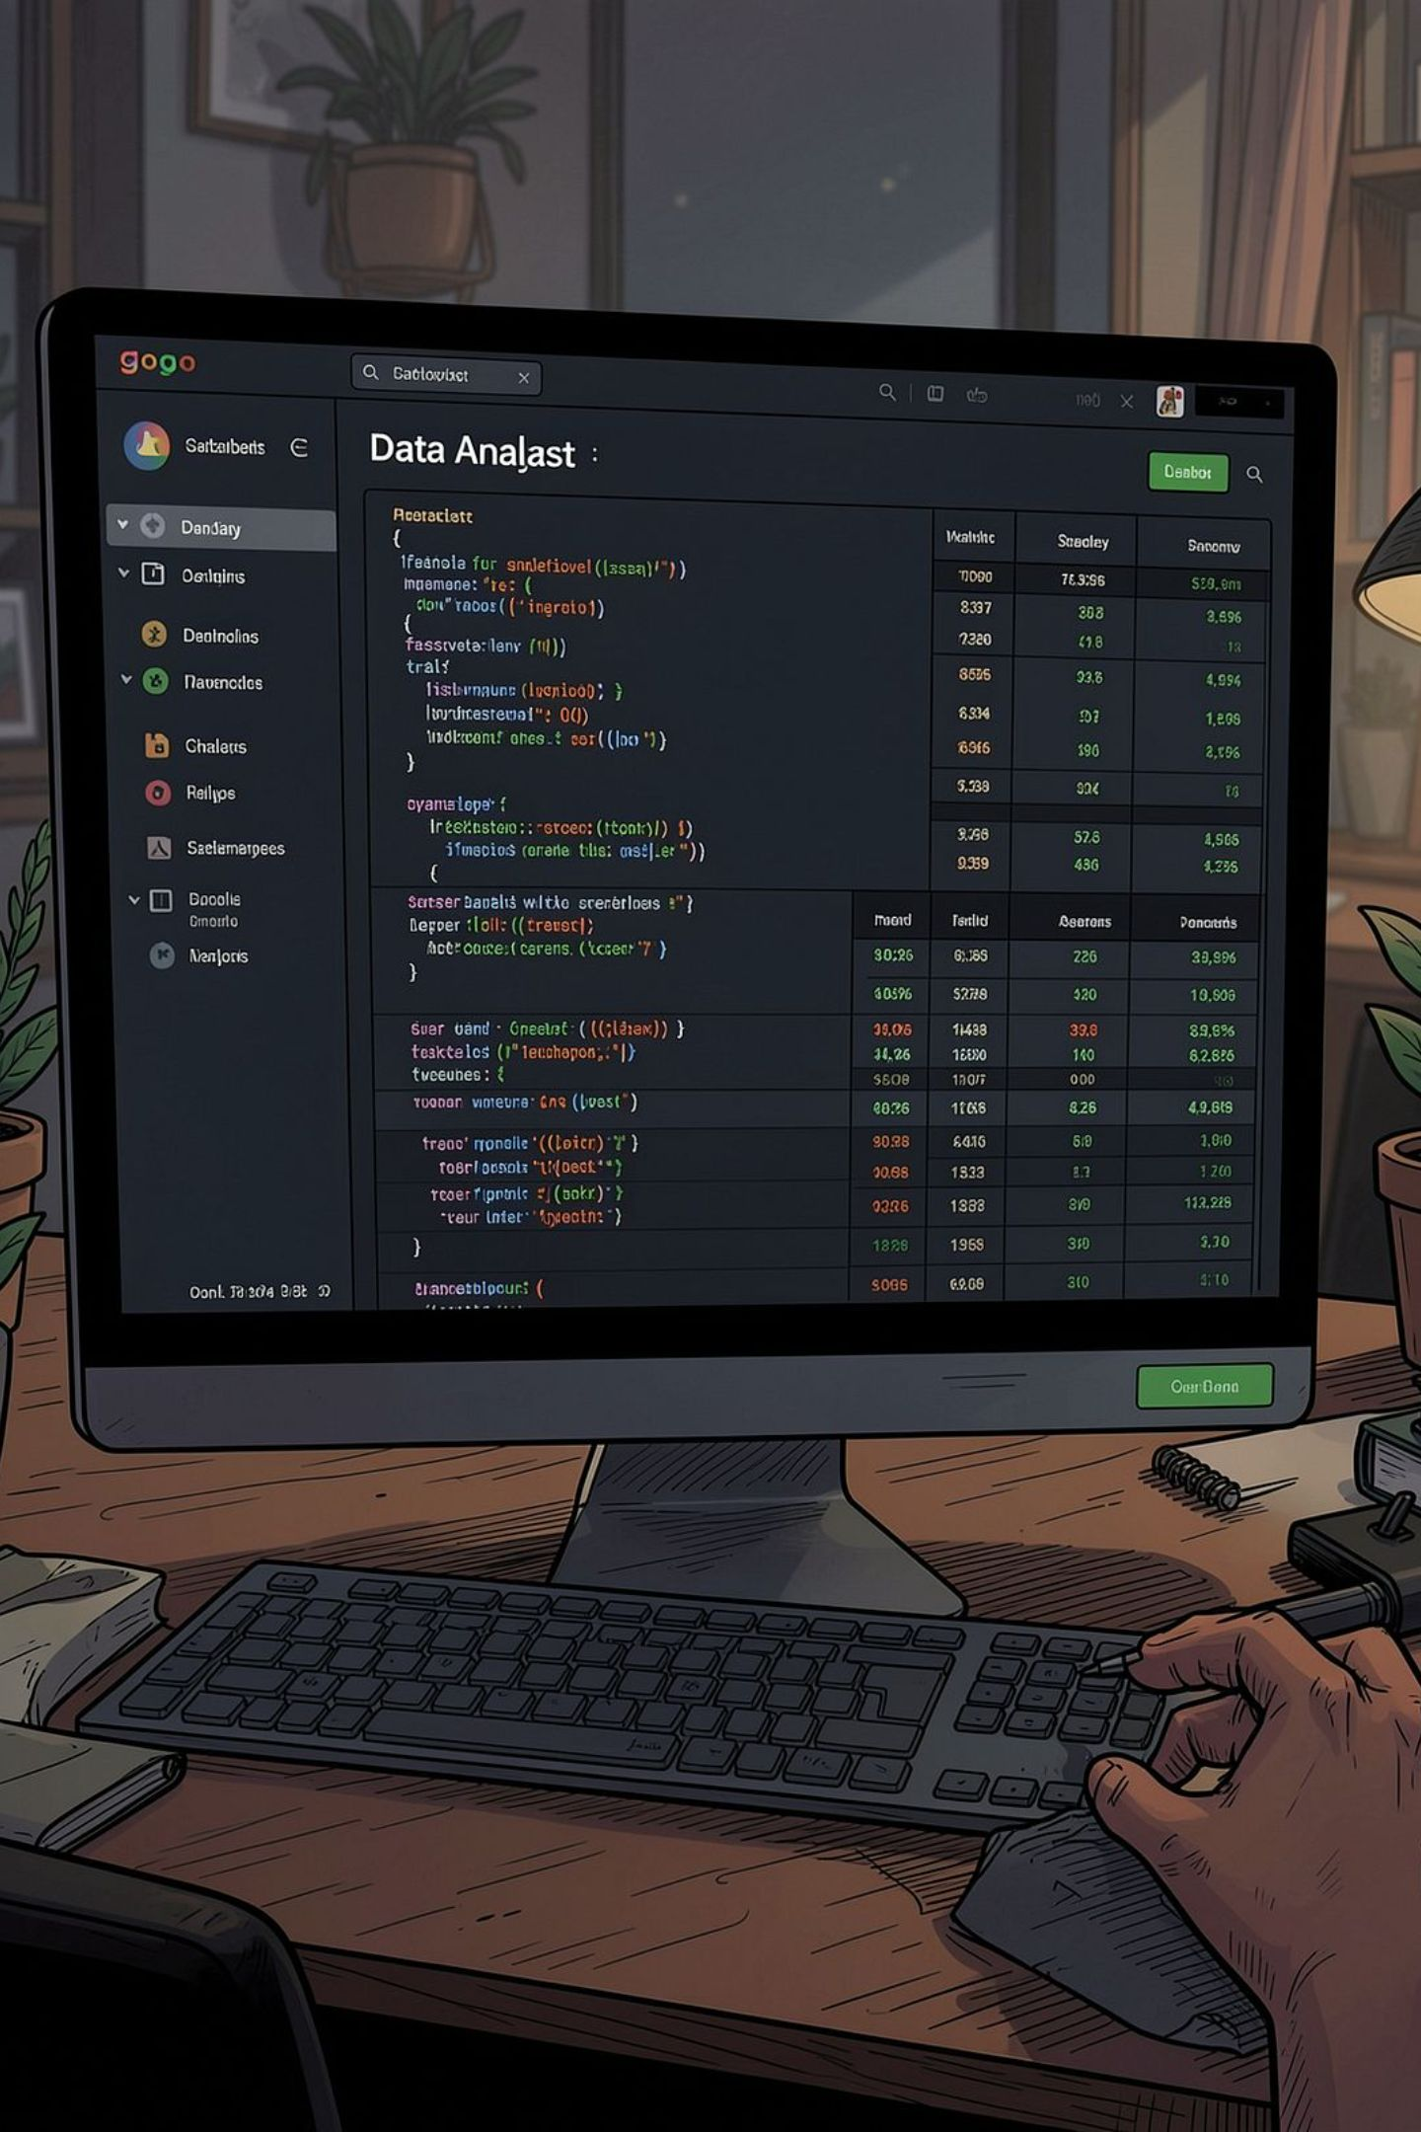
Customer Shopping Behavior — Project Snapshot
Analysis of 3,900 transactions to reveal spending patterns, segments, product preferences, and subscription behavior to guide strategy.

Slide 2
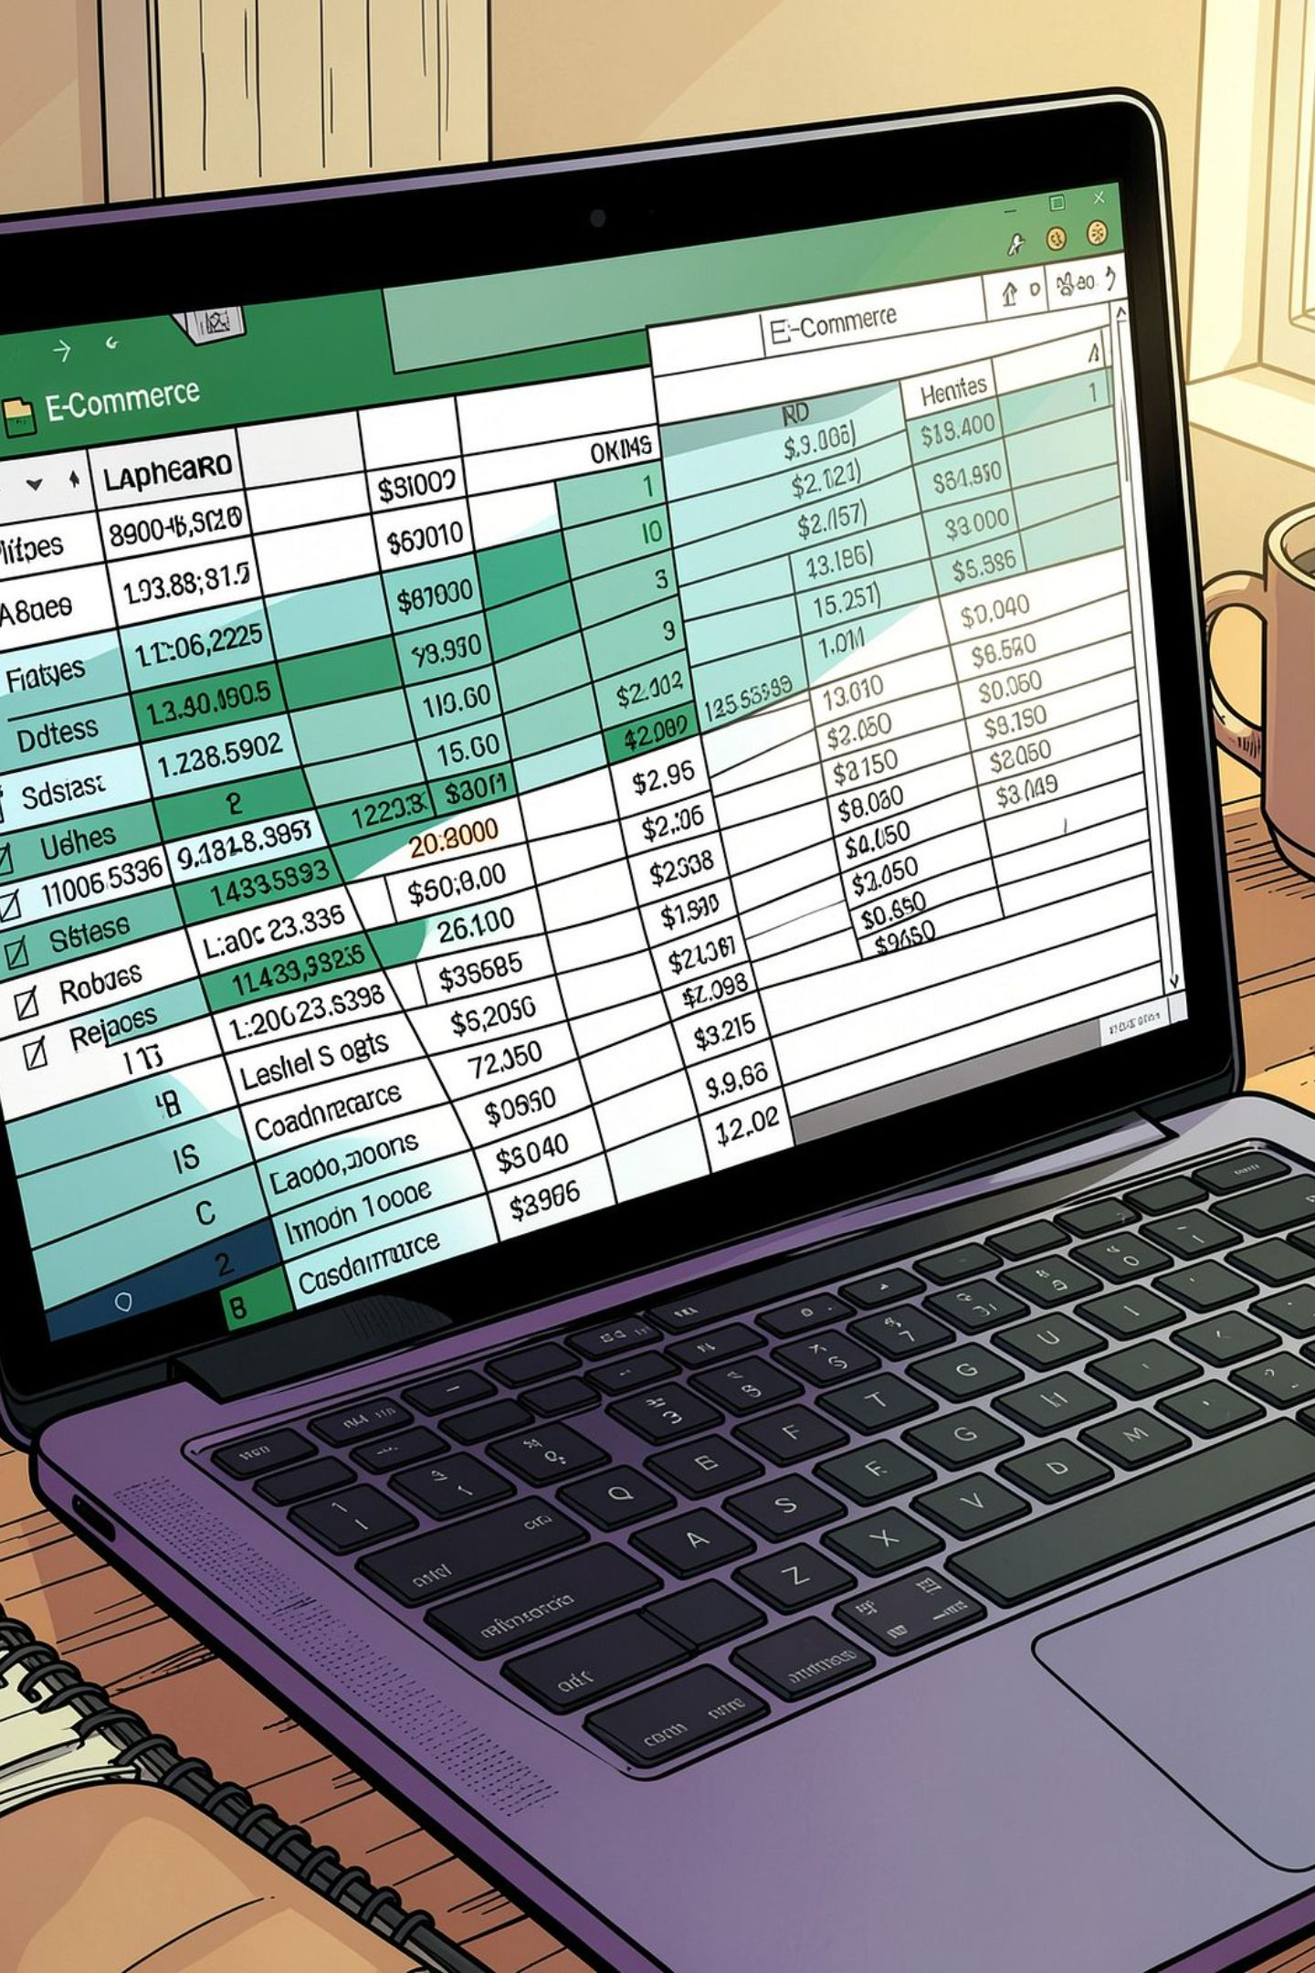
Dataset Summary
Scope
Key Features
Missing Data
3,900 rows × 18 columns
Demographics, purchase details, behavior flags (discounts, promo use), review ratings, shipping
37 missing values in Review Rating

Slide 3
Data Preparation & Feature Engineering
Loaded with Pandas; cleaned headers to snake_case. Imputed missing review_ratings using category medians. Engineered age_group bins and converted frequency to numeric days. Integrated cleaned table into a relational database for querying.

Slide 4
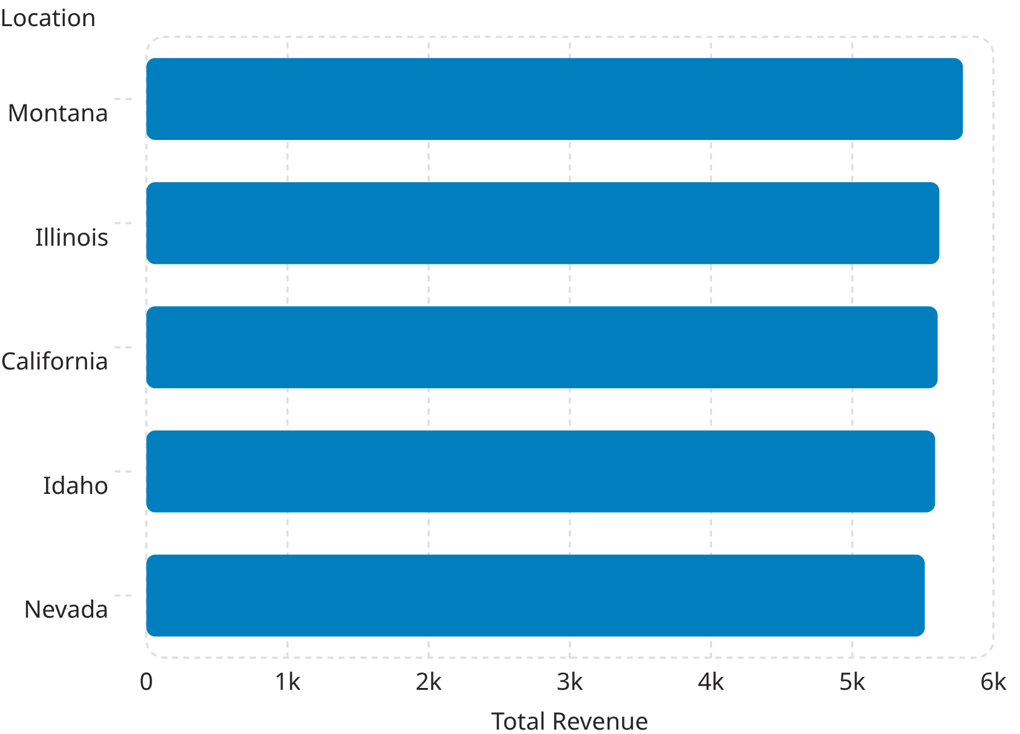
Exploratory Analysis — Top Locations
Geographic performance highlights top markets and average customer ages (e.g., Montana avg age 43.8). Use for targeted regional campaigns.

Slide 5
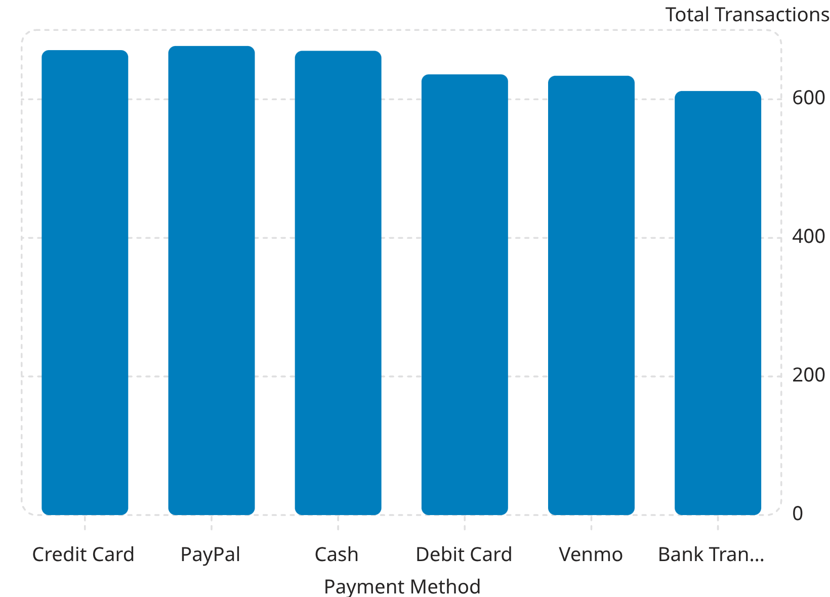
Payment Methods & Transaction Volume
Payment gateway volumes and revenue are similar across major methods—insight for payment partnerships and UX optimization.

Slide 6
Seasonal Category Performance
Seasonal cross-tab shows Clothing consistently leads revenue (notably Spring & Winter). Use to optimize inventory and seasonal promotions.

Slide 7
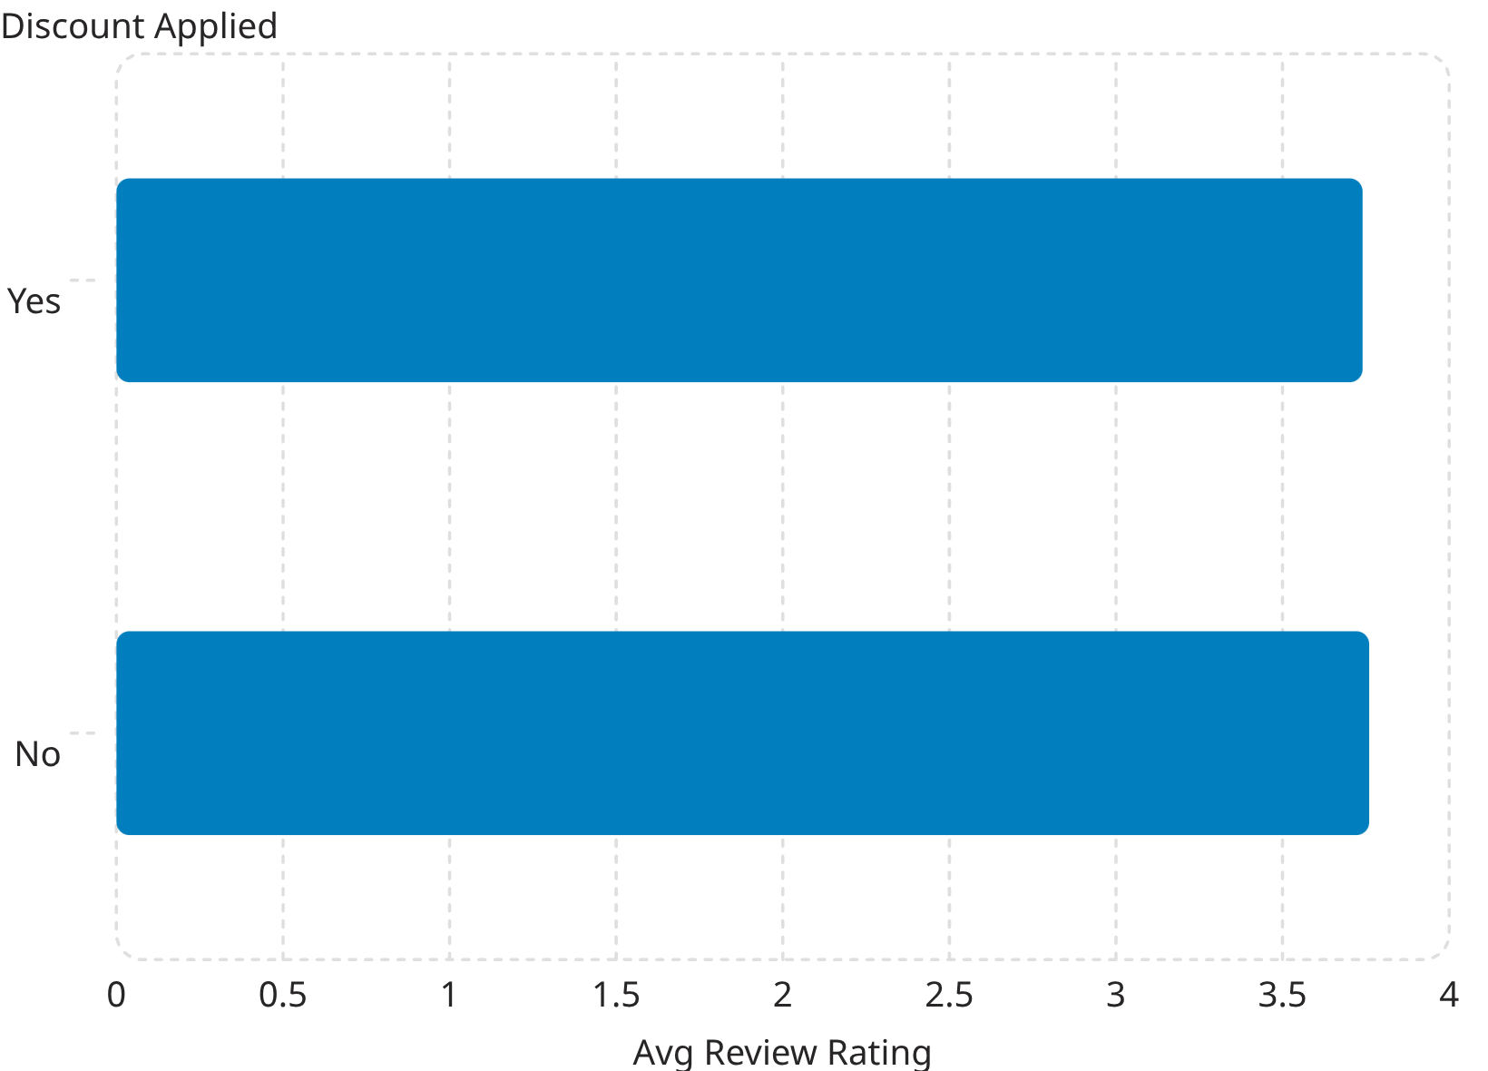
Discounts & Customer Satisfaction
Discounted purchases show a slight dip in average review rating (3.74 vs 3.76). Recommend evaluating margin trade-offs and post-purchase experience for discounted items.

Slide 8


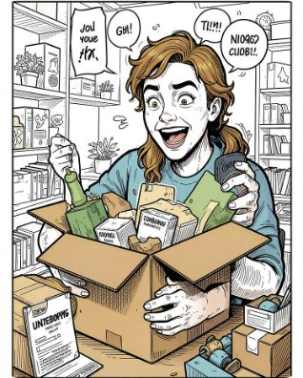
Customer Segments & Revenue
Loyal
Returning
New
3,116 customers — core revenue drivers; prioritize retention workflows.
701 customers — candidate for targeted reactivation offers.
83 customers — focus on onboarding and first-purchase incentives.

Slide 9
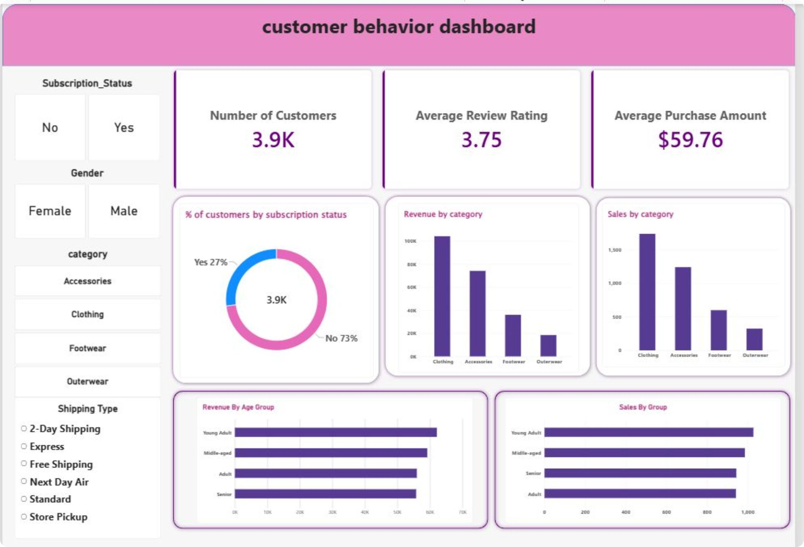
Dashboard Summary — KPIs
Total Customers
3.9K
Avg Purchase
$59.76
Avg Review Rating
3.75
Subscription Split
27% Yes / 73% No

Slide 10

Business Recommendations
Target Top Markets
Increase Subscriptions
Refine Discounting
Lifecycle Campaigns
Allocate marketing to high-revenue locations identified in location analytics.
Introduce tiered rewards to convert non-subscribers and boost retention.
Assess margin impact of discounts and optimize for long-term profitability.
Use New/Returning/Loyal segmentation to deploy tailored retention and reactivation workflows.

